Slide 1

Sales Territory Analysis – Northeast Region
Maine and New Jersey Territories
Presented by: Dimitri Nji

Slide 2

agenda
Project Goal
The goal of this project was to analyze in-store sales performance for two assigned territories in the Northeast region:
Maine
  Territory Manager: Erbayne Middleton
New Jersey
  Territory Manager: Miami Vue
My analysis focused on:
- Revenue trends
- Store performance
- Customer behavior
- Product category performance
- Marketing recommendations
Notes:
For this project, I analyzed two assigned sales territories in the Northeast region: Maine and New Jersey. The purpose of the analysis was to compare sales performance across stores, customers, and product categories in order to make recommendations for future marketing efforts.

Slide 3

Technologies and Tools Used
Tools Used
Python
Pandas
Matplotlib
Jupyter Notebook
GitHub
Files Used
StoreSales.csv
StoreDetail.csv
Products.csv
ProductCategories.csv
customer_list.csv
Notes:
I used Python for the entire analysis. Pandas helped with data cleaning, merging, and calculations, while I used Matplotlib to create charts and visualizations. I completed the project inside Jupyter Notebook and used GitHub to save and manage my work.

Slide 4
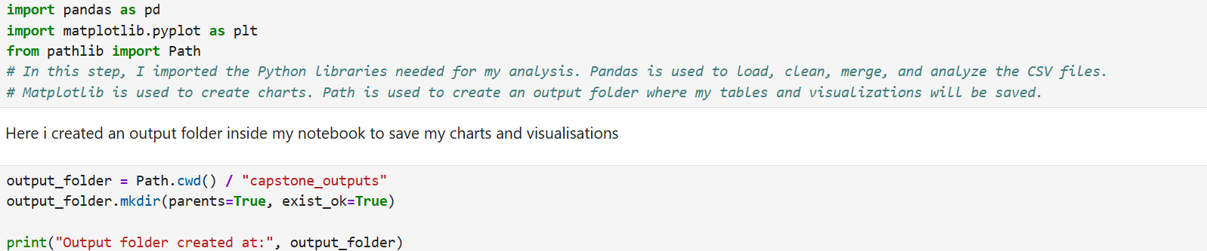
Setting up my analysis workspace
Notes:
I imported Pandas to load, clean, and analyze the sales data,
I imported Matplotlib to create charts and visualizations for my findings and I use Pathlib to create an output folder where all tables and charts images can be saves in an organized location

Slide 5

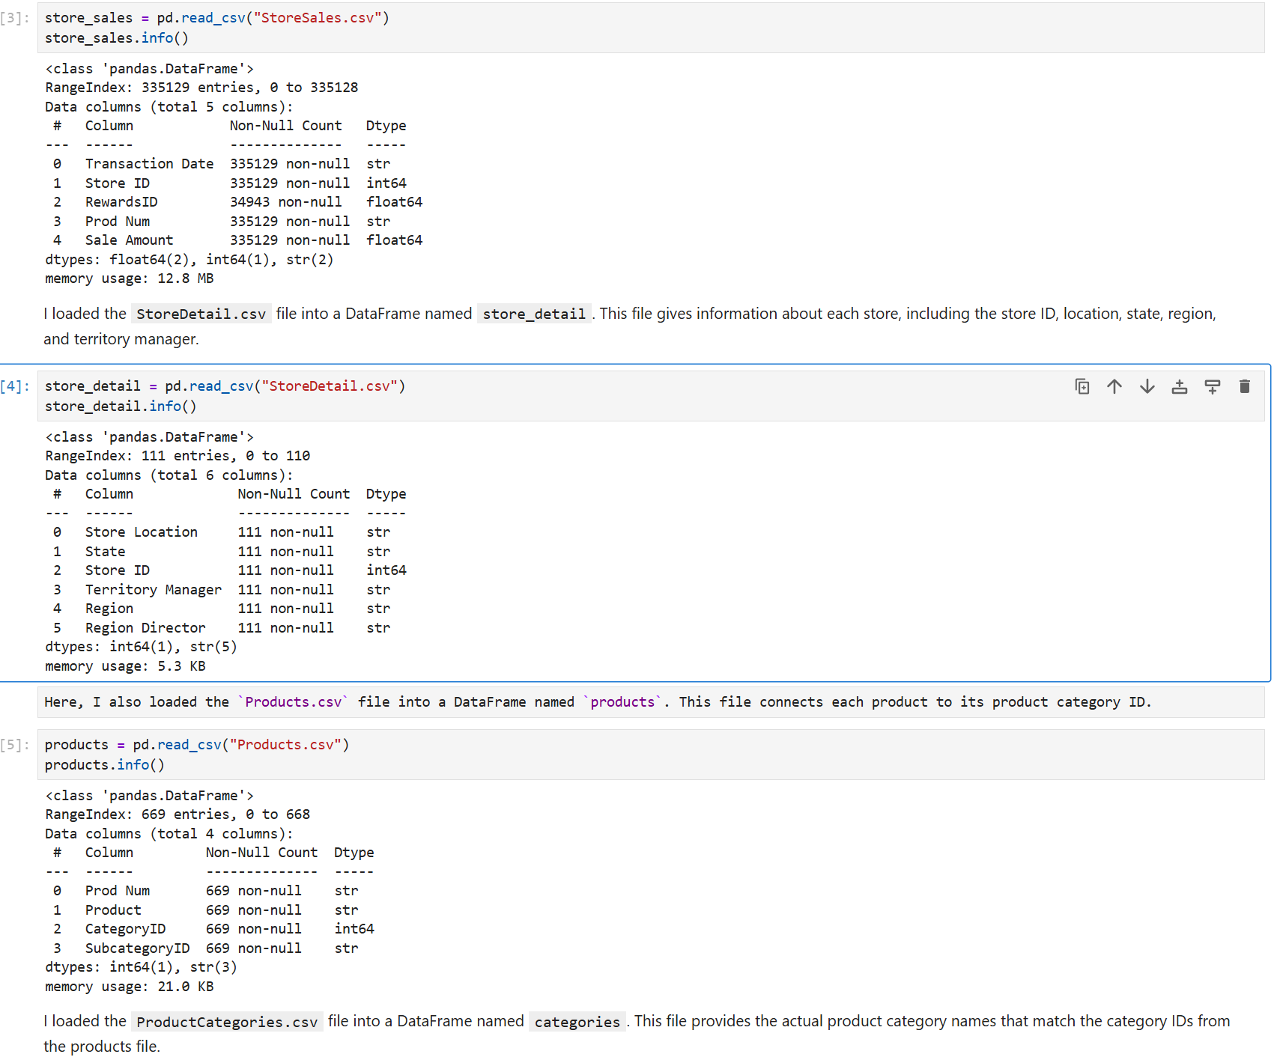
Loading CSV Files
Notes:
First, I loaded the StoreSales.csv file into a DataFrame called store_sales, which contains all in-store sales transactions for my analysis. Then, I loaded StoreDetail.csv into store_detail to access store information such as location, state, region, and territory manager. Next, I loaded Products.csv into products, which links each product to a category ID. I also loaded ProductCategories.csv into categories to map those IDs to actual category names. Finally, I loaded customer_list.csv into customers using a pipe separator, since the file uses ‘|’ instead of commas.”

Slide 6

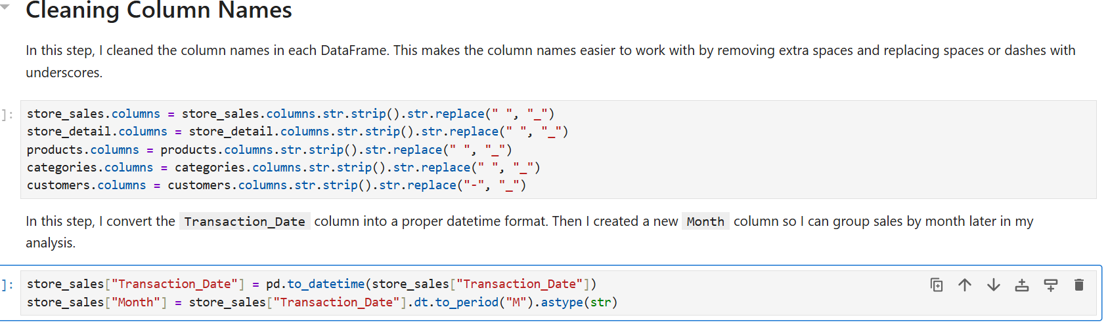
Data cleaning
Notes:
In this step, I cleaned the column names in each DataFrame by removing extra spaces and replacing spaces or dashes with underscores to make them easier to use. I also converted the Transaction_Date column into a datetime format and created a new Month column to support monthly sales analysis later in my project.”

Slide 7
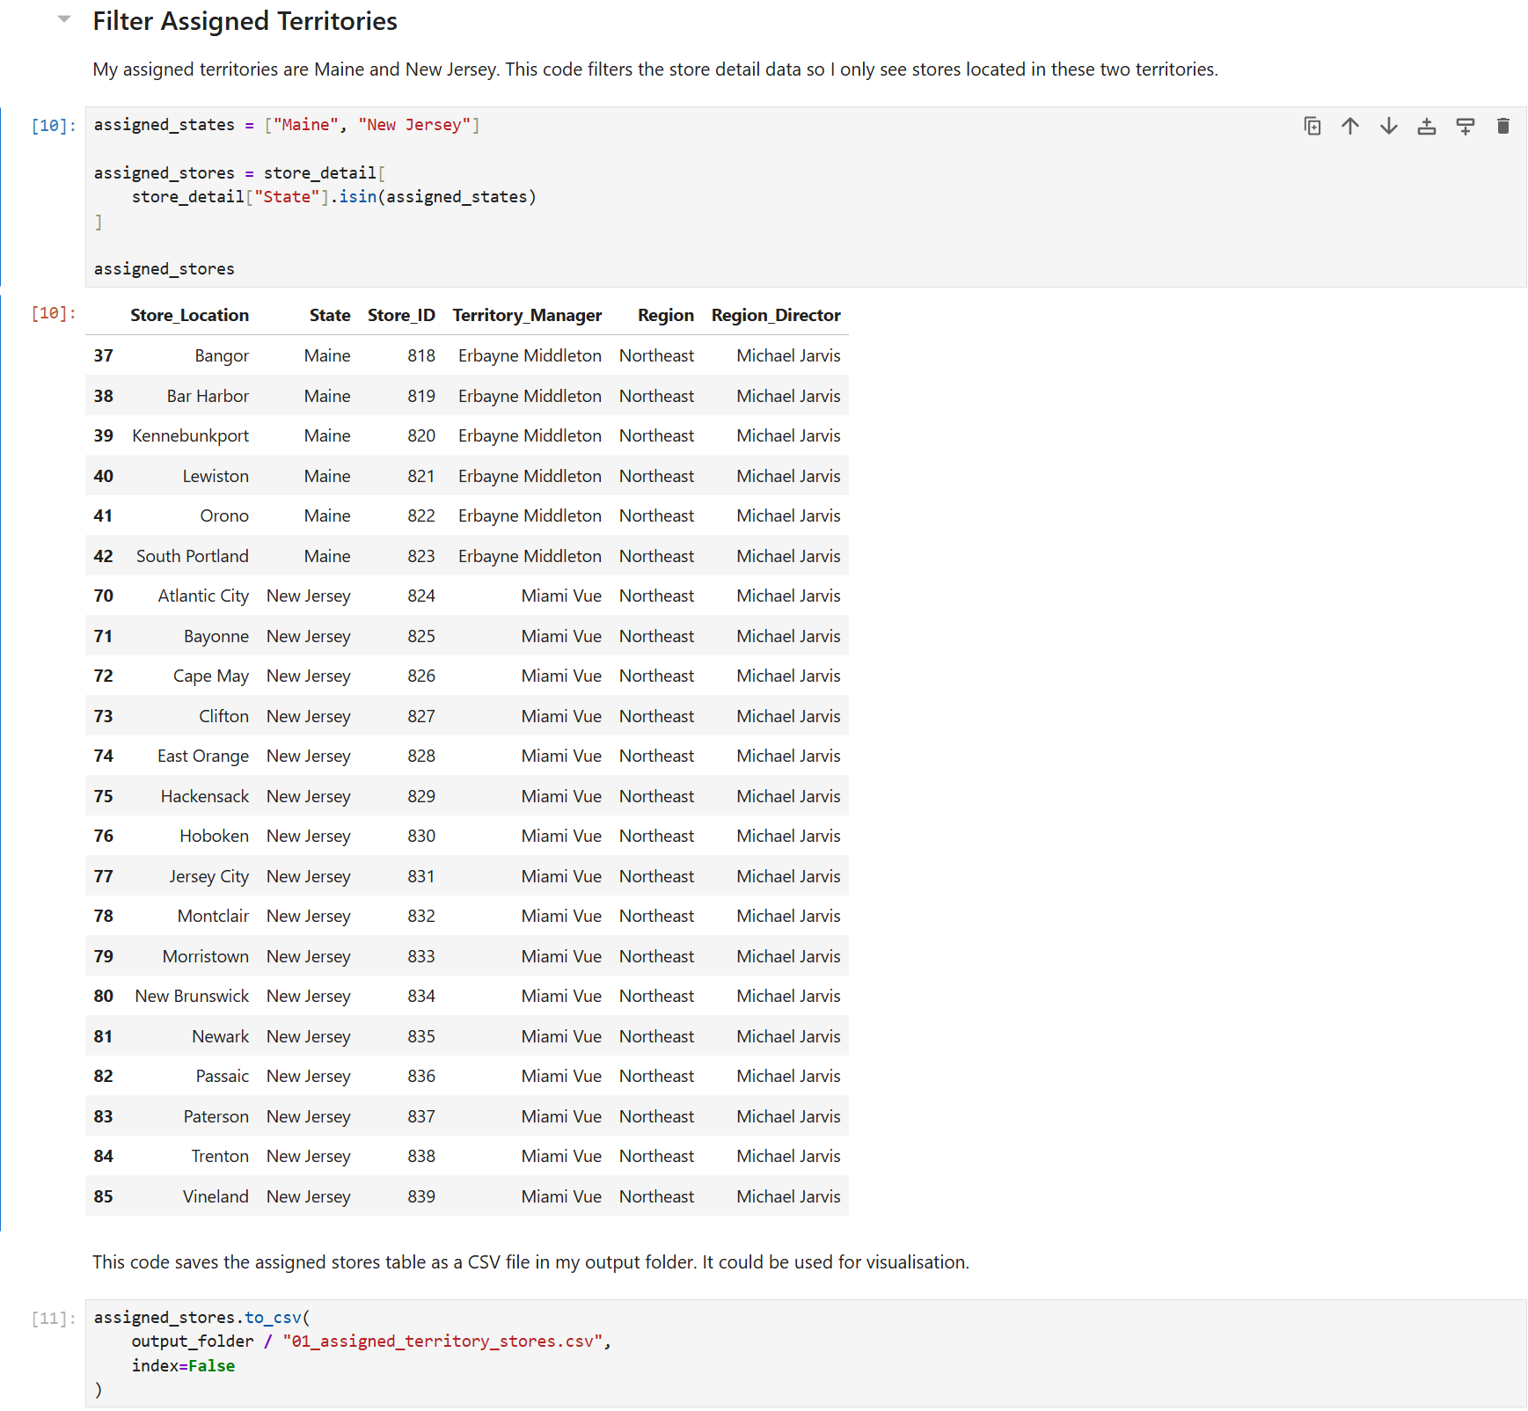
Quote
Notes:
My assigned territories are Maine and New Jersey. This code filters the store detail data so I only see stores located in these two territories. And I made sure to save this table as a csv in my output folder

Slide 8
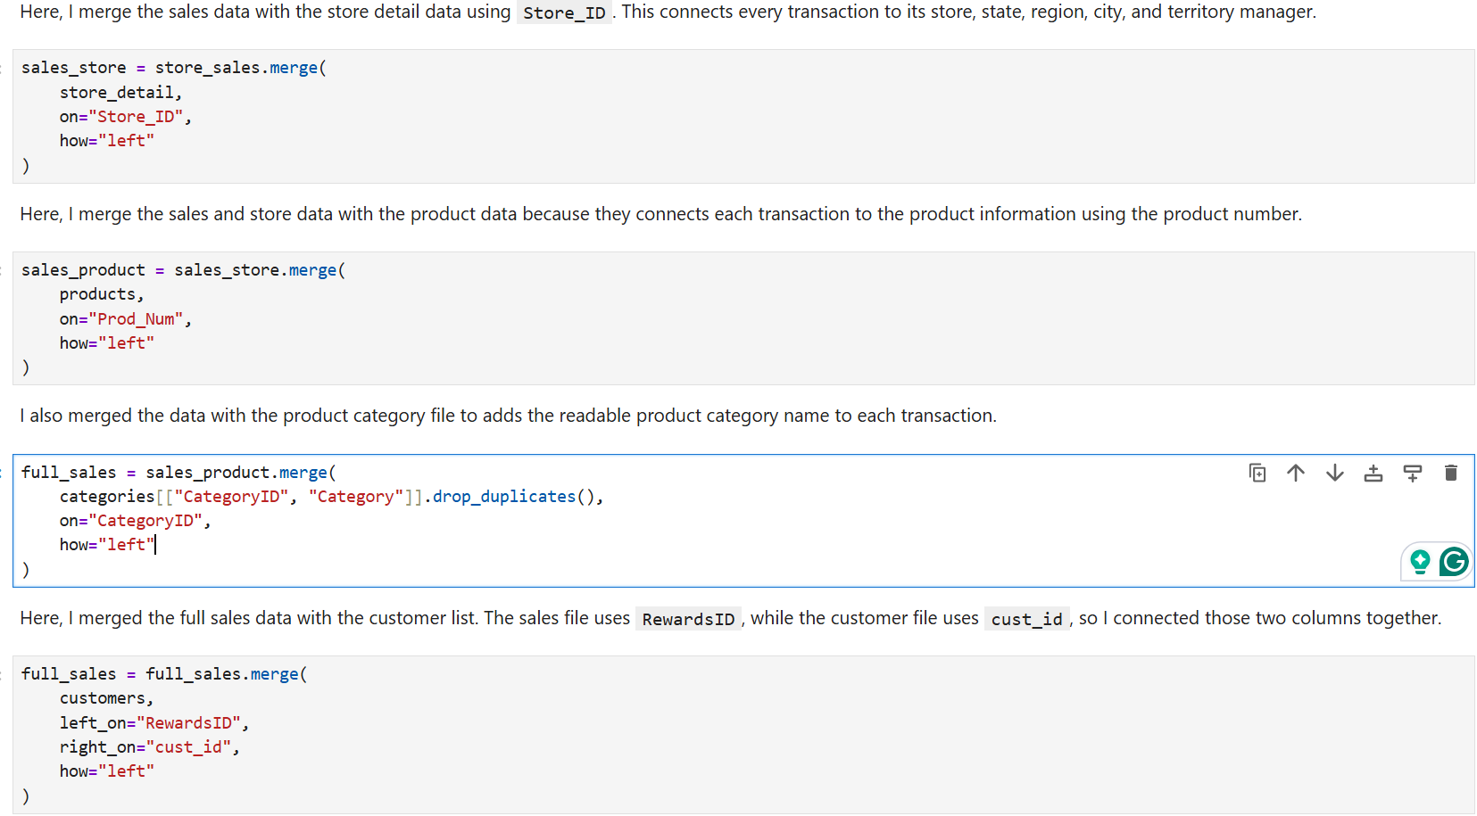
Notes:
In this step, I merged the sales data with the store details, product information, product categories, and customer list. This connected each transaction to its store location, product category, and customer details, creating one complete dataset for analysis

Slide 9
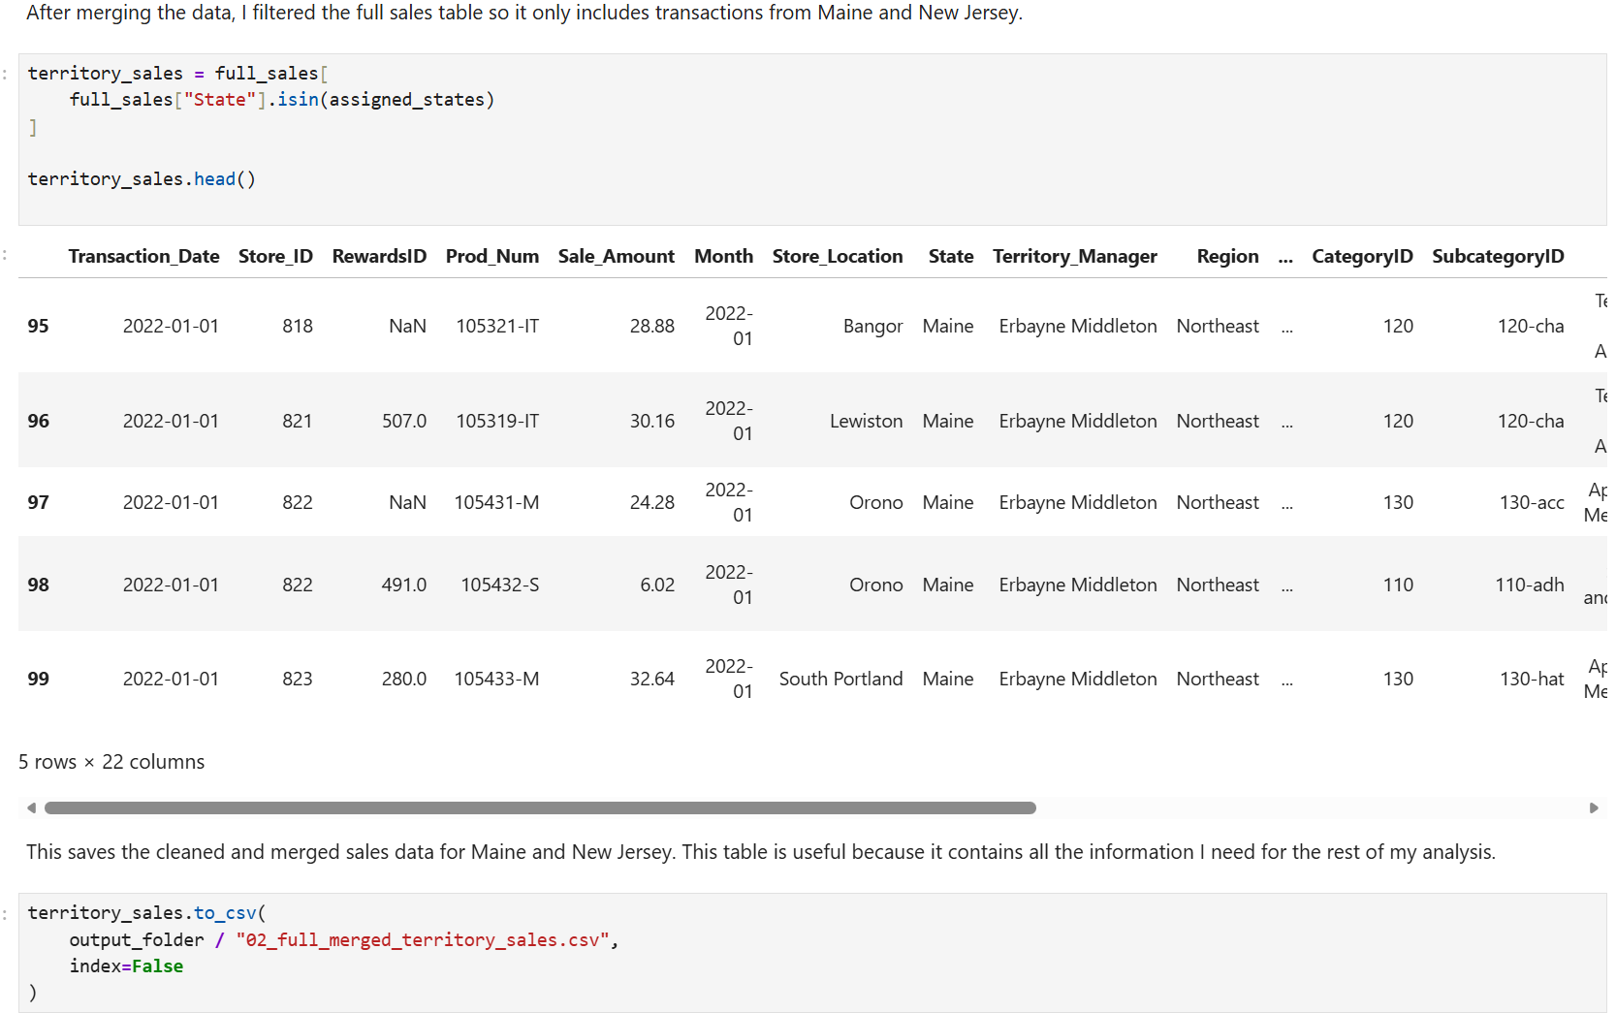
Notes:
After merging the data, I filtered the full sales table so it only includes transactions from Maine and New Jersey.

Slide 10
Core Marketing Analysis
Who are the territory managers for the sales territories assigned? What are the store IDs and cities for the stores in each assigned sales territory?
What is the monthly total revenue for in-store sales in each of the two sales territories over the full period covered by the data?
How would you rank the sales performance of each store in each sales territory? Which are the top-performing stores?
Comparing the customer ID from the customer list data with the rewards ID from the sales data, who were the top customers in each sales territory?
What is the number of transactions per month by product category in each assigned territory? What is total sales revenue per month by category?
What is your recommendation for where to focus marketing attention in the next quarter? How did the analysis help support this recommendation?

Slide 11
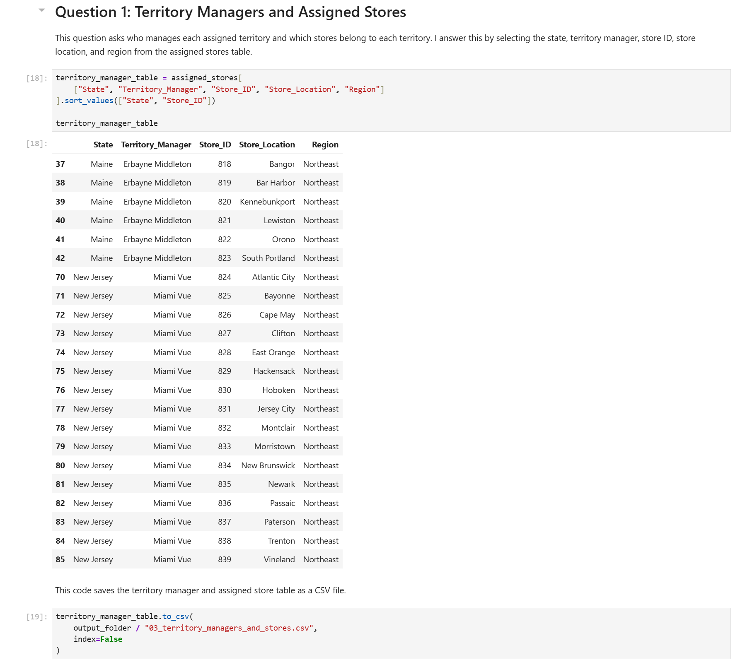
Territory Managers and Assigned Stores
Analysis Goal
Identify:
Territory managers
Store IDs
Store locations
Assigned territories
What I Did
Filtered the data for Maine and New Jersey only
Selected relevant store and manager information
Findings
Maine and New Jersey each had multiple assigned stores
Territory manager information was successfully linked to each store
Notes:
For the first question, I filtered the data to only include Maine and New Jersey. I then selected the territory manager, store ID, and store location information so I could identify all stores assigned to each territory

Slide 12
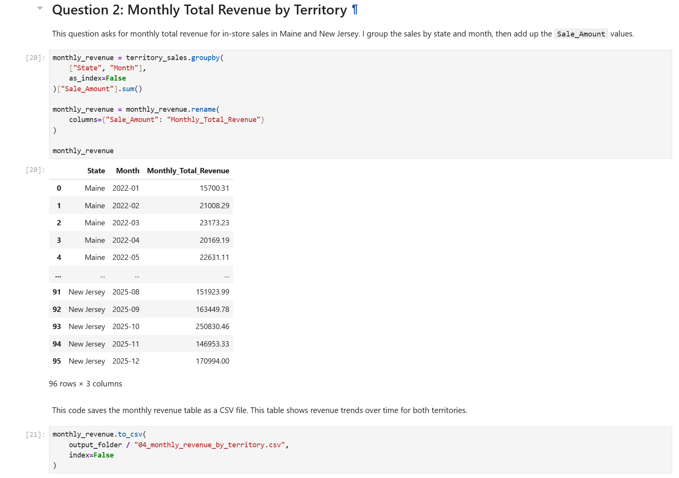
Monthly Revenue Analysis
Analysis Goal
Determine monthly in-store sales revenue for:
Maine
New Jersey
What I Did
Grouped data by:
  State
  Month
Summed total sales revenue

Slide 13
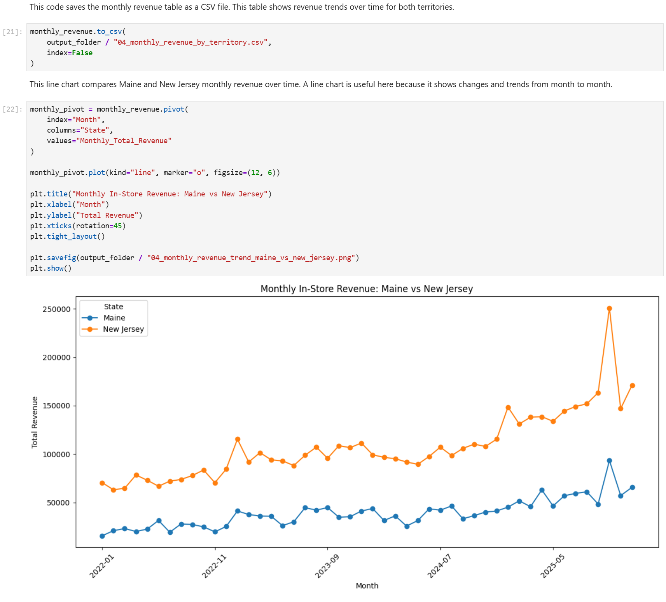
Monthly Revenue Analysis
Visualization
(Insert Monthly Revenue Line Chart)
Why I Chose a Line Chart
Best for showing trends over time
Makes month-to-month comparisons easier
Customizations
Added chart title
Rotated x-axis labels
Added markers for readability
Notes:
For monthly revenue analysis, I grouped sales by state and month and then calculated total revenue. I used a line chart because line charts are effective for showing trends over time and comparing changes between territories

Slide 14
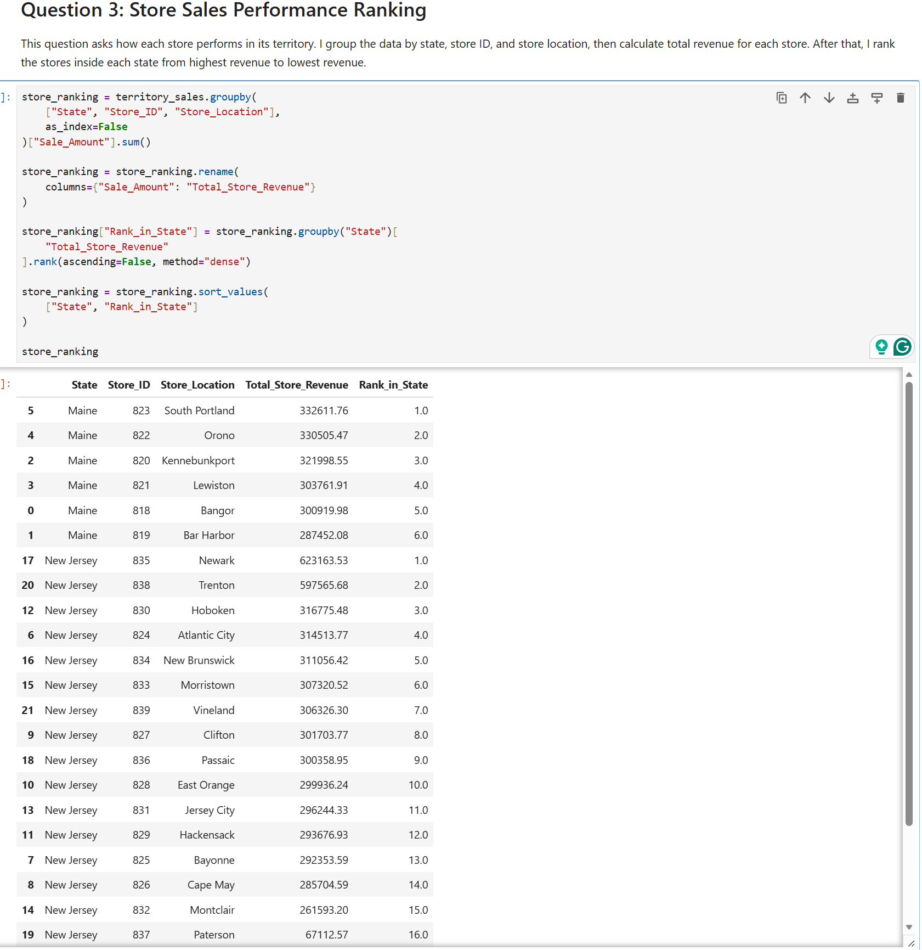
Store Performance Ranking
Question Answered
Which stores are the top-performing stores?
Analysis Steps
Grouped sales by:
  State
  Store ID
  Store Location
Calculated total revenue per store
Ranked stores from highest to lowest revenue
Notes:
I ranked stores based on total sales revenue. This helped identify which stores were performing the best and which stores may need additional marketing support

Slide 15
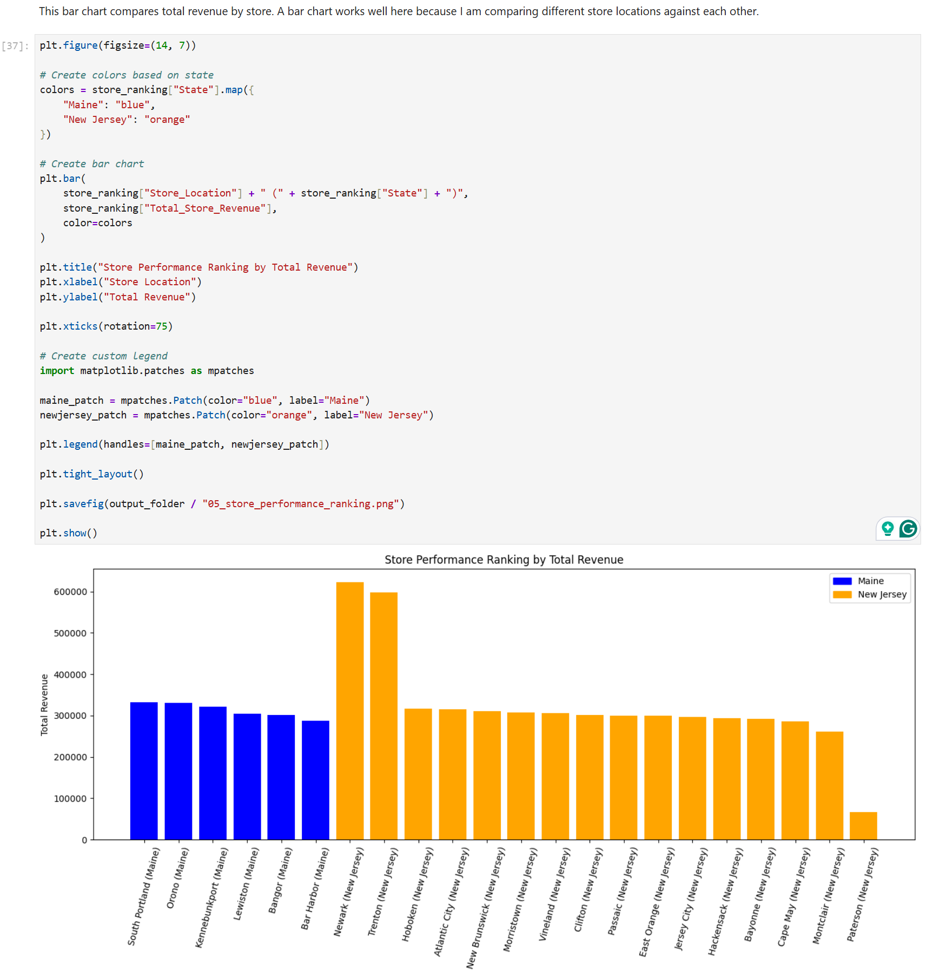
Store Revenue Comparison
Chart Explanation
Displays total revenue for each store
Compares store performance across territories
Helps identify top-performing and lower-performing locations
Customizations Added
Rotated store labels
Increased chart size
Added descriptive chart title
Added axis labels
Notes:
This chart visually compares store performance. Some stores clearly generated more revenue than others, which helps identify where marketing efforts may already be successful.

Slide 16
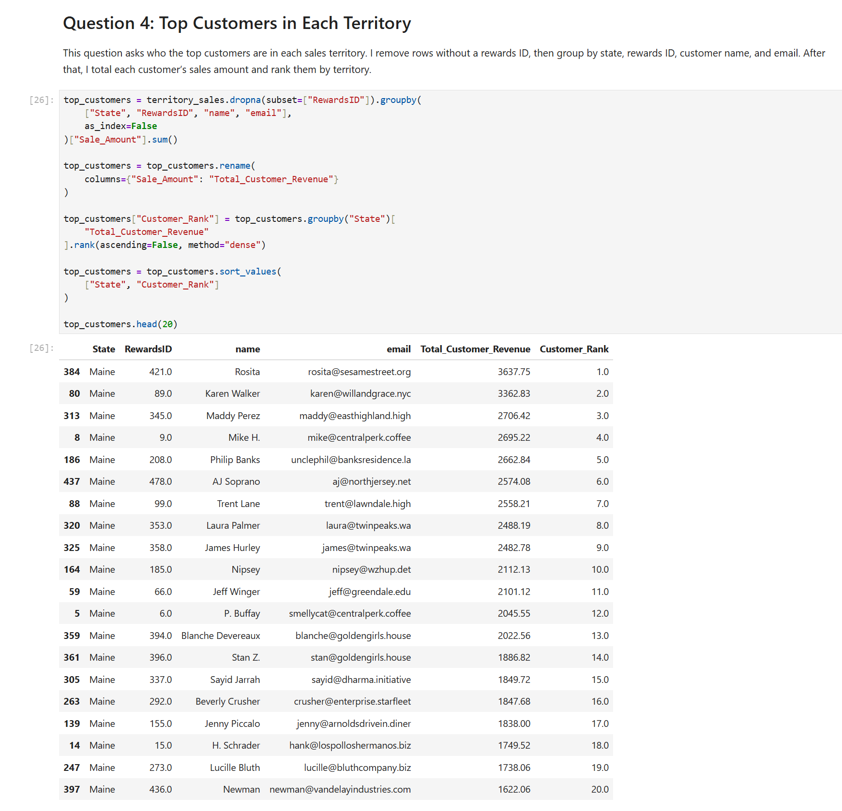
Top Customers in Each Territory
Question Answered
Who are the top customers in each territory?
Analysis Steps
Matched:
  RewardsID
  Customer ID
Grouped customer purchases by territory
Calculated total spending per customer
Ranked customers by revenue generated
Findings
Rewards customers contributed strongly to sales
Some customers made significantly more purchases than others
Notes:
I compared the rewards IDs from the sales data with the customer list to identify the highest-spending customers in each territory. Rosita from Maine with a total revenue of 3637.75 worth of purchase comes in first and Ben Linus from New Jersey tops the list in this region with 4810.66 worth of purchase

Slide 17
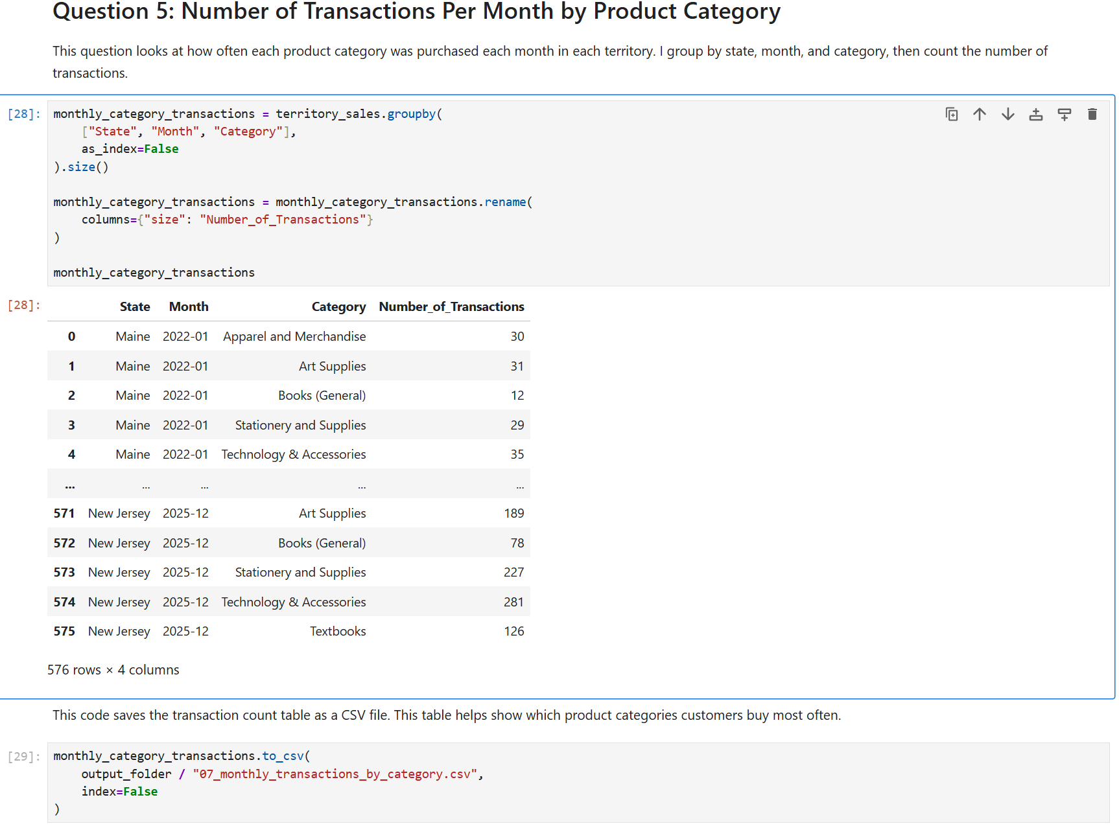
Product Category Analysis
Questions Answered
Which product categories had the most transactions?
Which categories generated the most revenue?
Analysis Steps
Grouped data by:
  Territory
  Month
  Product Category
Counted transactions
Summed category revenue
Key Insight
Popular categories had:
High transaction counts
Strong revenue performance
Notes:
This analysis helped identify which product categories customers purchased most often and which categories generated the highest revenue
With Technology & accessories toping the list for both Maine and New Jersey While Books (General) comes last with the lowest number of transaction counts each month.

Slide 18
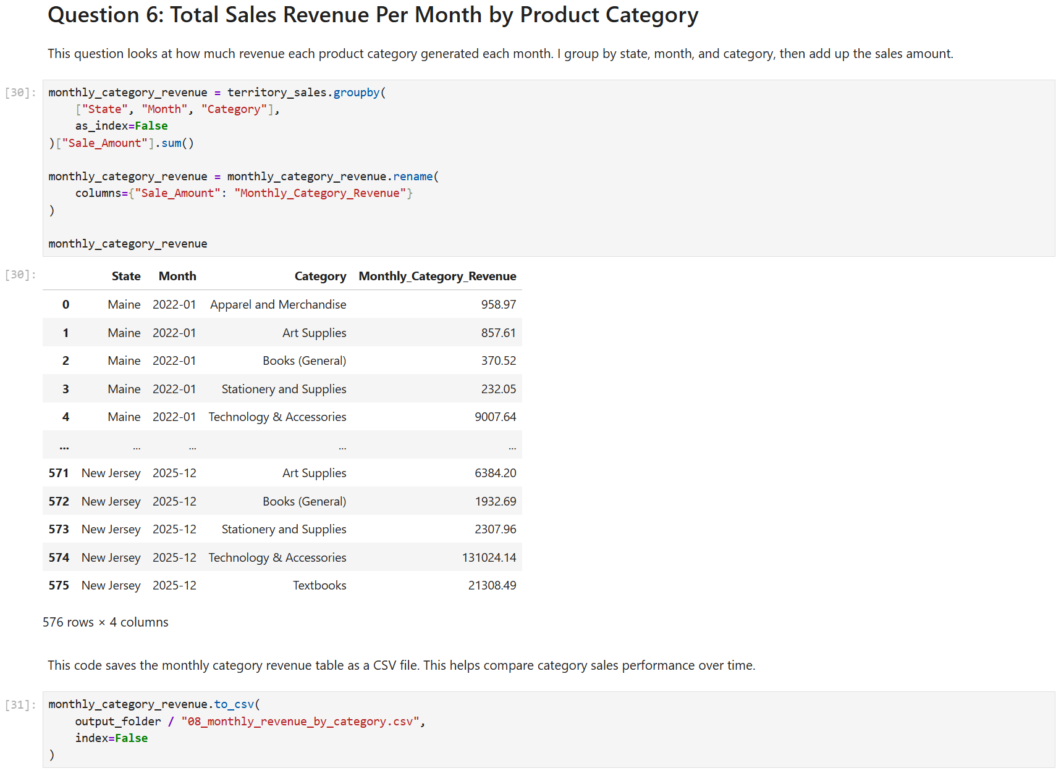
Revenue by Product Category
Chart Explanation
Compares category revenue between territories
Shows strongest and weakest product categories
Helps identify areas for marketing growth
Why This Chart Matters
This chart helps the marketing team decide:
Which categories should receive more promotion
Which categories already perform well

Slide 19
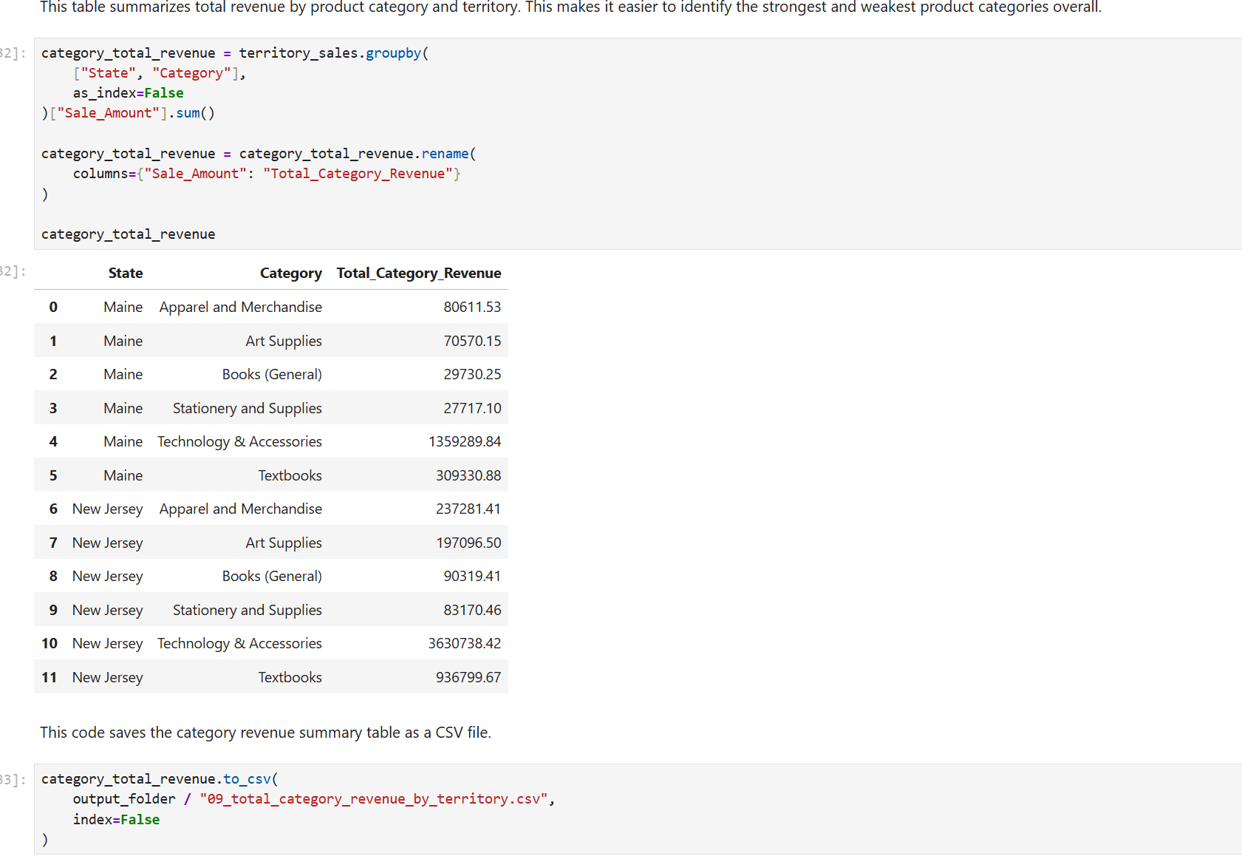

Slide 20
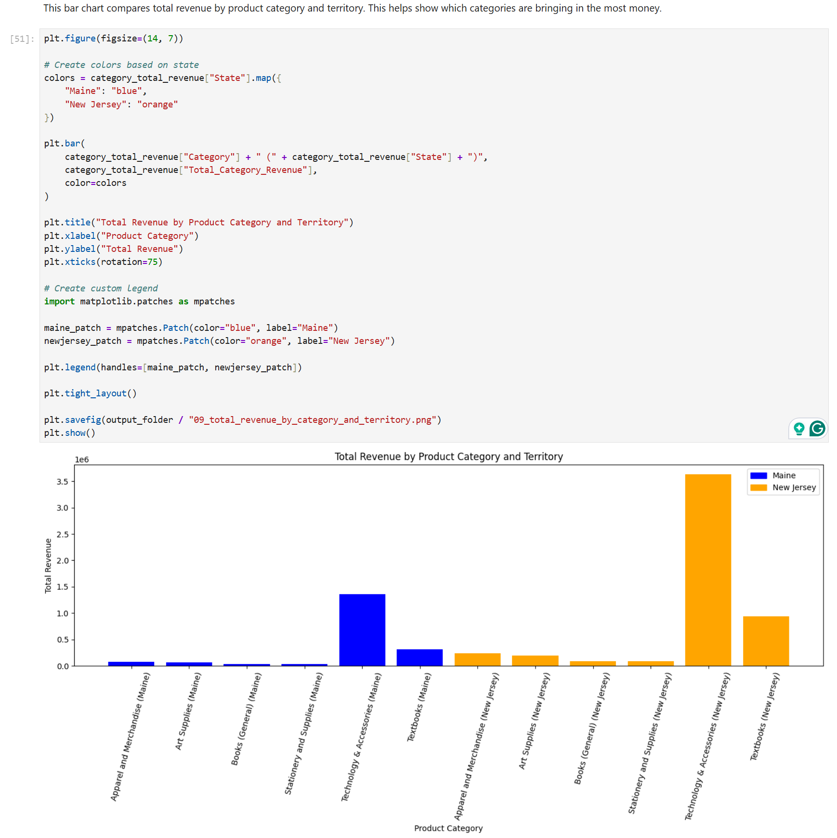

Slide 21
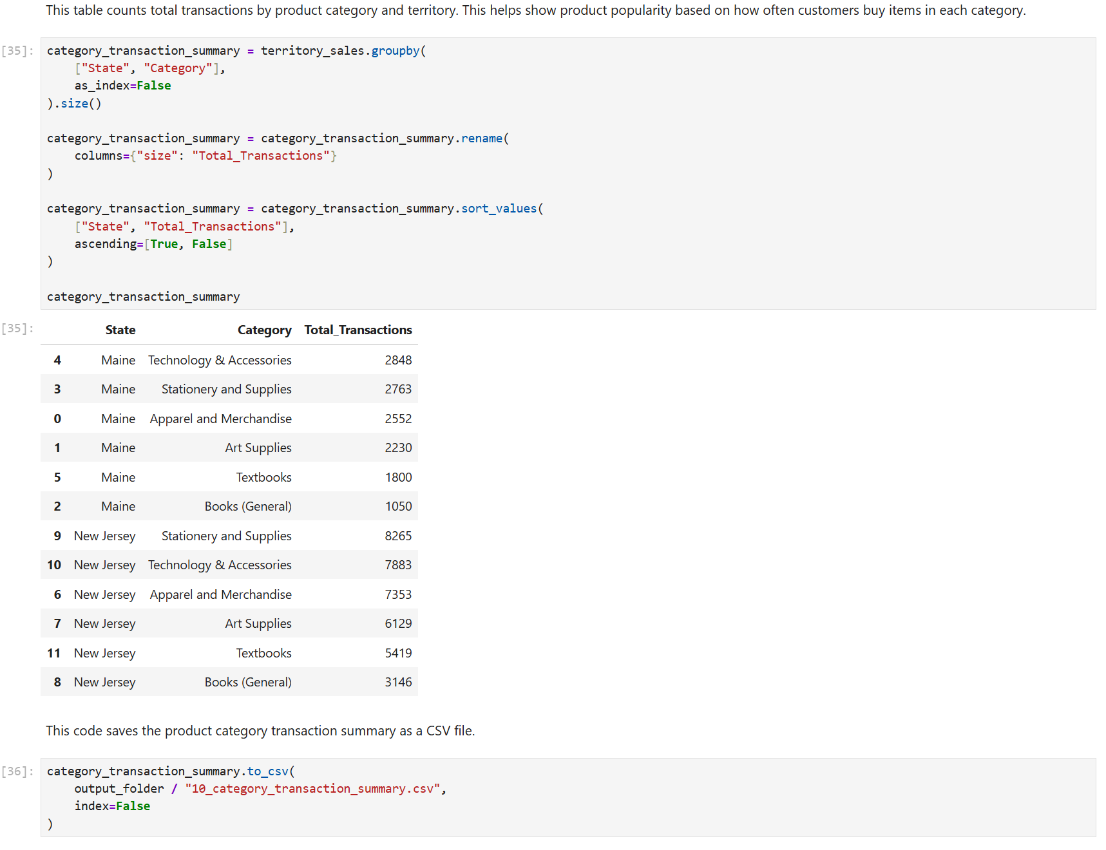

Slide 22
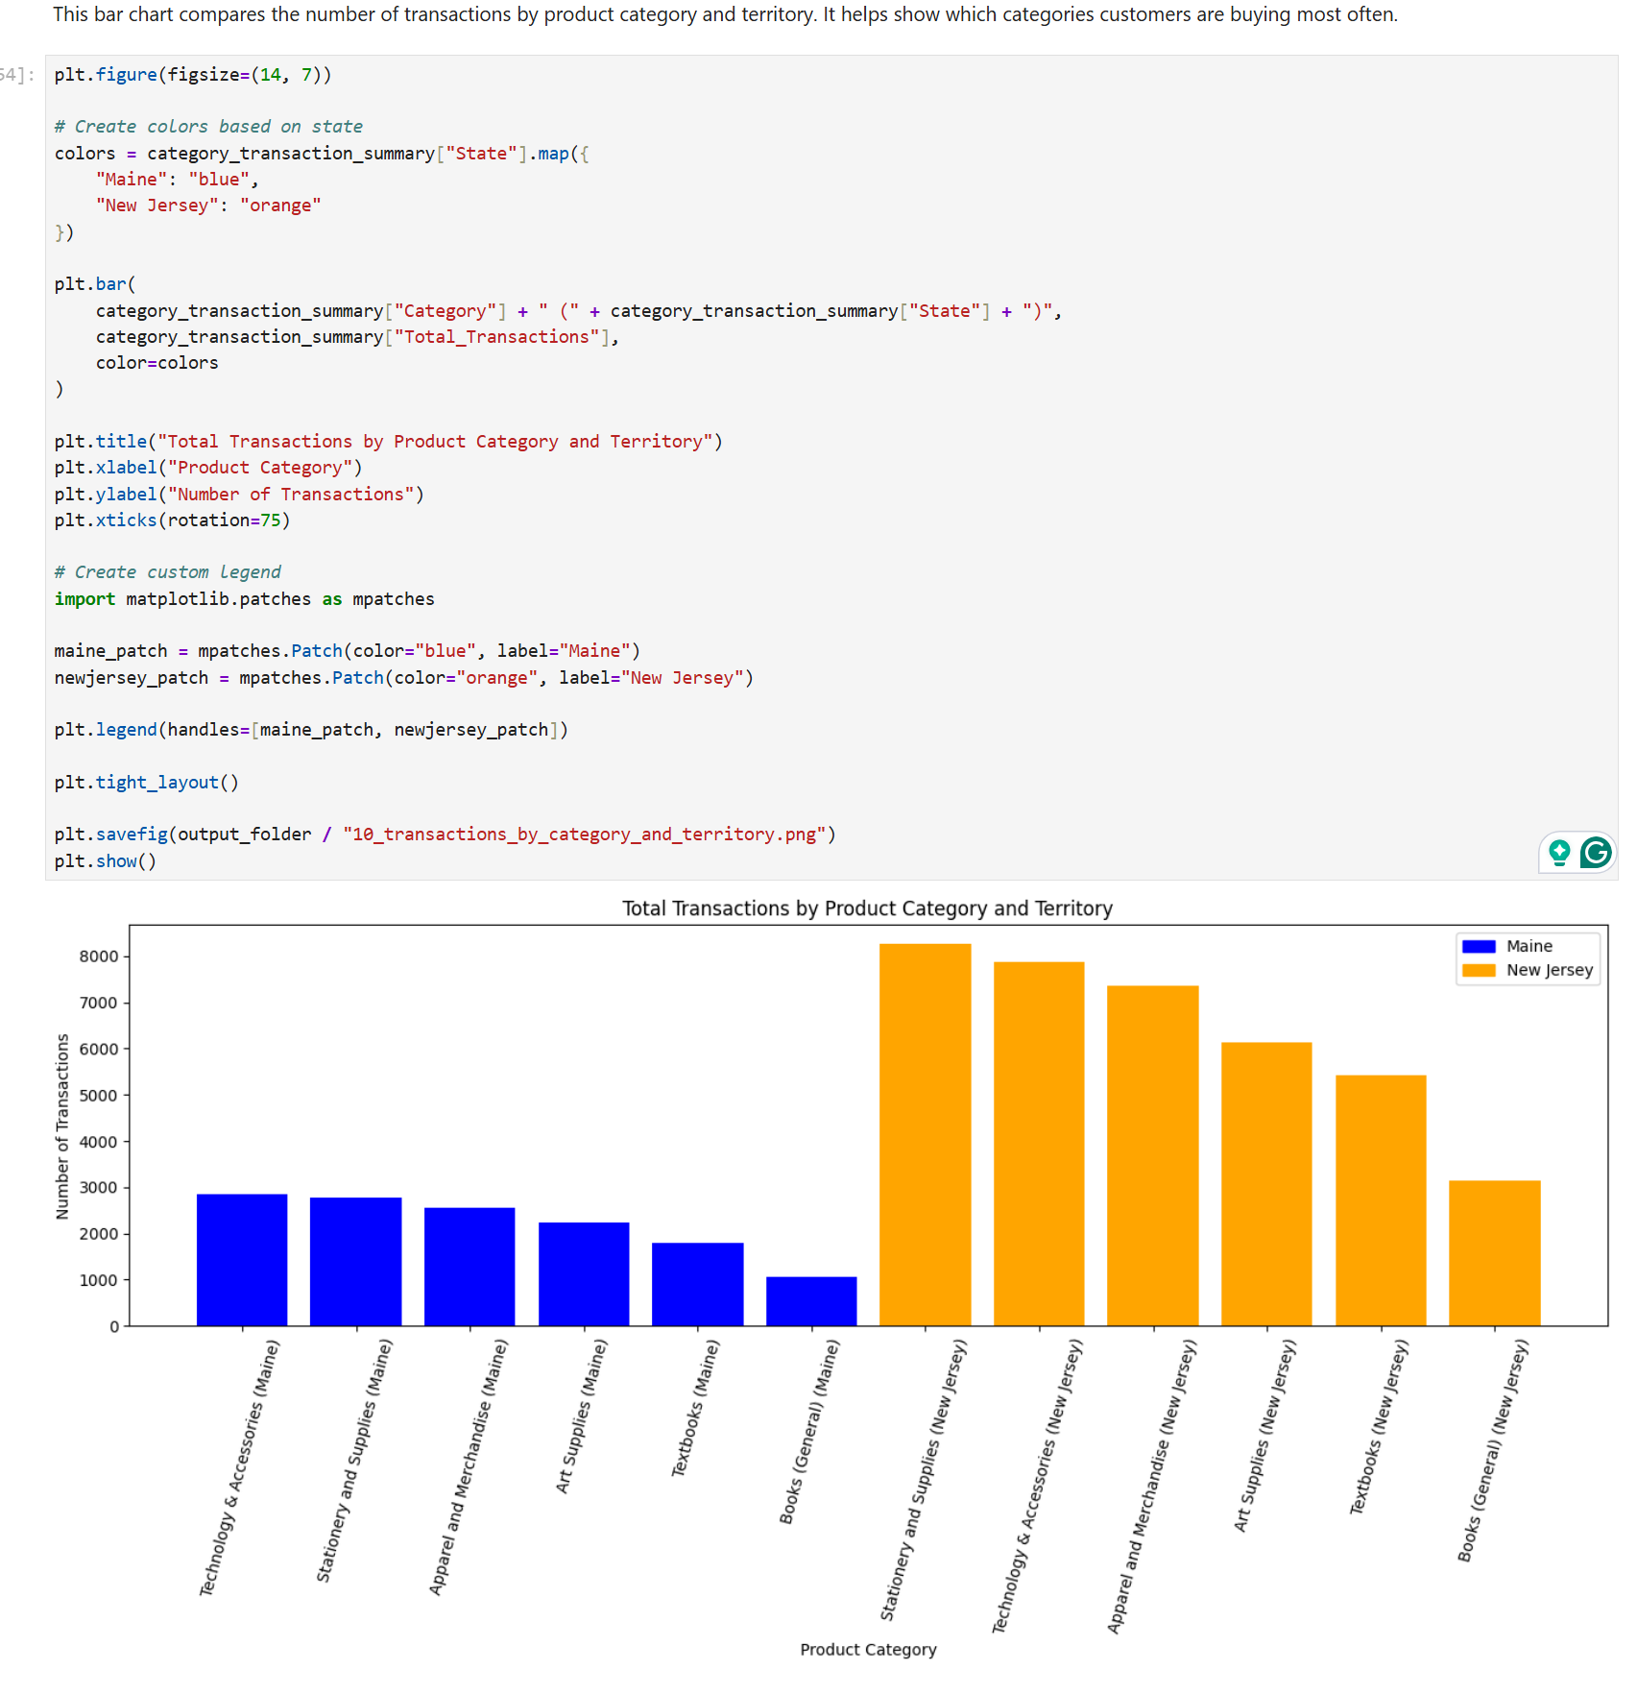

Slide 23
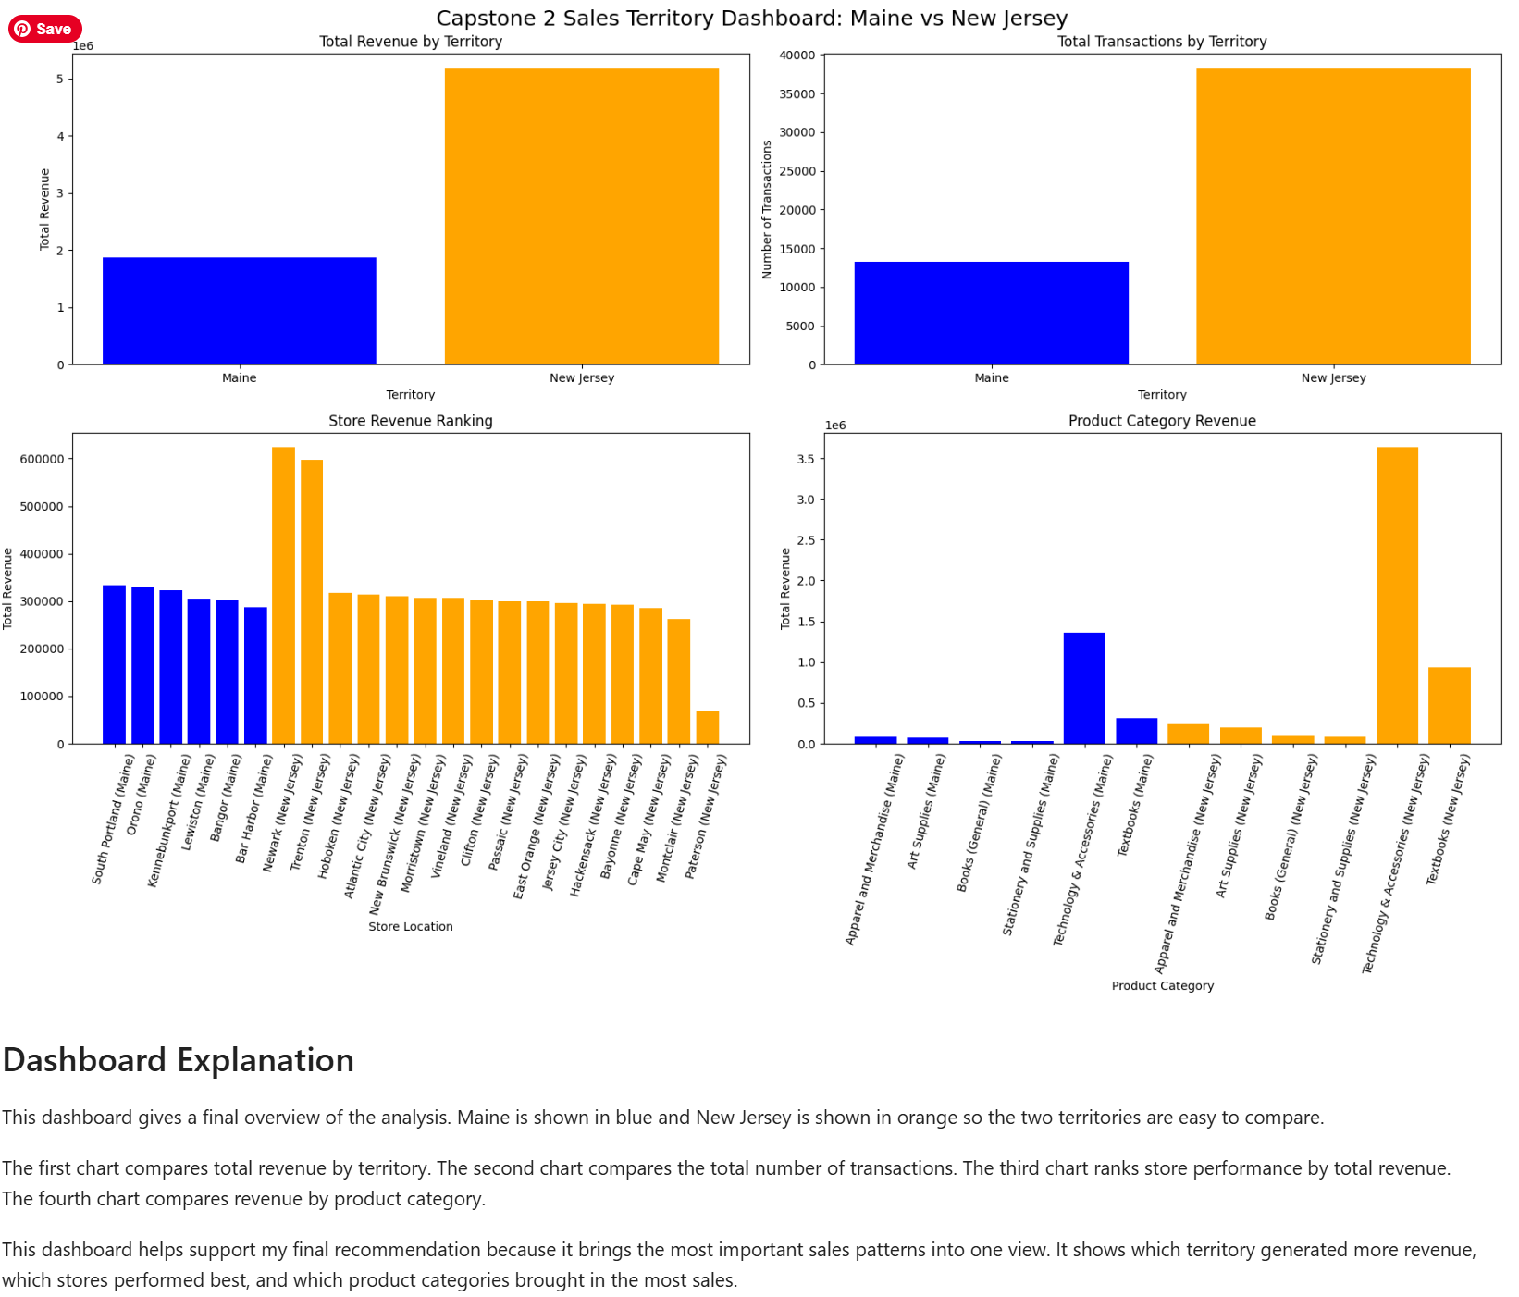
DashBoard

Slide 24

Key Findings
Major Discoveries
Some stores consistently outperformed others
Certain product categories generated much higher revenue
Rewards customers contributed strongly to repeat purchases
Monthly revenue trends varied between territories
Business Impact
This analysis helps:
Improve marketing strategy
Target weaker stores
Increase category growth
Improve customer engagement
Notes:
The data revealed important trends in store performance, customer behavior, and category sales. These findings can help improve future marketing decisions

Slide 25
Final Marketing Recommendation
Recommended Focus Areas
Support lower-performing stores like the store 819 in the bar harbor location
Promote weaker product categories with discounts, and publicity.
Target top rewards customers with campaigns
Study strategies used by top-performing store as they could be used to boost the performance of the low performing stores
Why
Top-performing stores show what already works
Lower-performing stores represent growth opportunities
Popular categories can drive additional sales growth
Notes:
My recommendation is based on the sales patterns, store rankings, customer spending, and category performance discovered during the analysis

Slide 26
Conclusion
Summary
I analyzed Maine and New Jersey sales territories
I compared store and category performance
I identified customer and sales trends
I created visualizations to support findings
Lastly I developed data-driven marketing recommendations
    GitHub Repository Link https://github.com/Di-Fai/Capstone_2.git
This project helped me apply Python, Pandas, and data analysis techniques to a real business scenario. Thank you for listening

